Slide 1
Week 5: Evaluating niche-based distribution models
Peter Galante
Outline:
Maxent model tuning
Model validation
Model evaluation
Evaluation statistics
Model complexity and advanced considerations
(thanks to Richard Pearson, Rob Anderson, and Mary Blair for content)
Notes:
‘Species distribution modeling’ or ‘Ecological niche modeling’ or ‘habitat suitability modeling’ or ‘bioclimate envelope modeling’

Slide 2
Flow diagram detailing the main steps required for building and validating a correlative species distribution model
Observed species’ distribution
(presence-only or presence/absence)
Predicted species’ distribution.
Prediction may be for a different region or for a different time period
Modeling algorithm
(e.g. Maxent)
GIS database of ‘raw’ environmental variables (e.g. temperature,
precipitation, soil type).
Processing to
generate variables of importance in defining species’ distributions
(e.g. maximum daily
temperature, frost days, soil water balance)
Statistical assessment of model performance

Slide 3
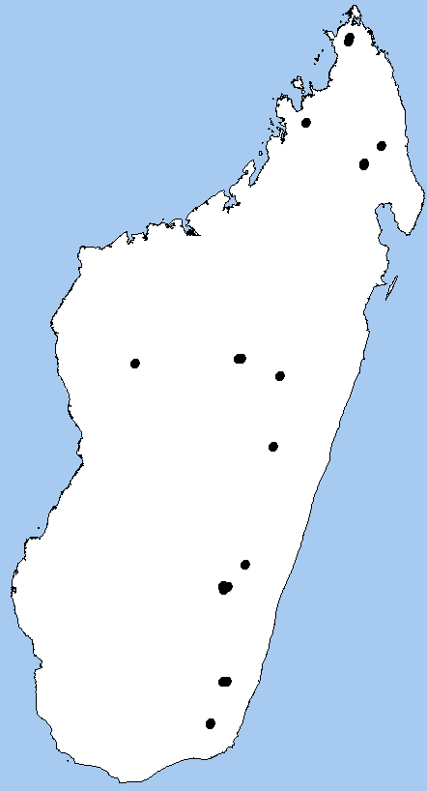
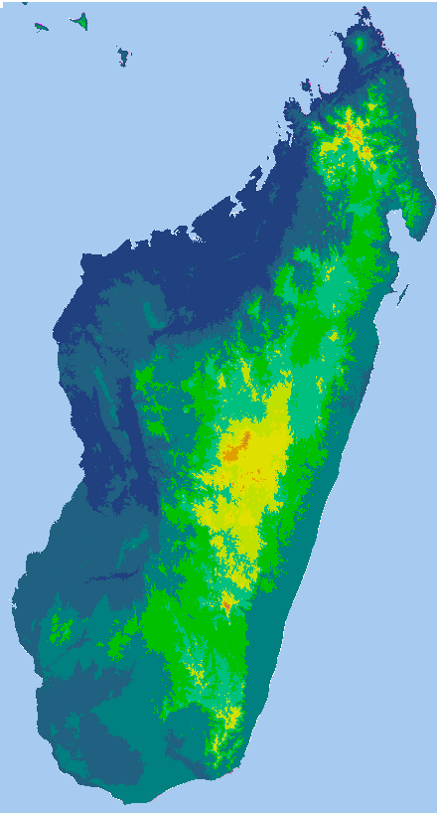
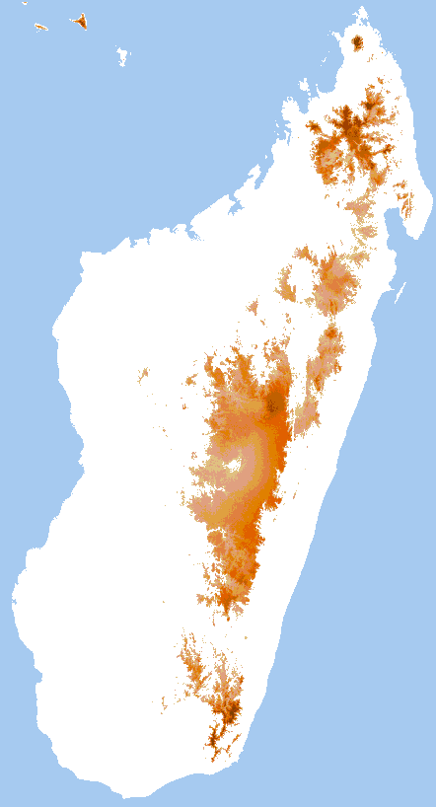
Niche Models
+
Maxent
Abiotically suitable areas
Occurrence localities
19 bioclimatic variables
(Hijmans, 2005)

Slide 4
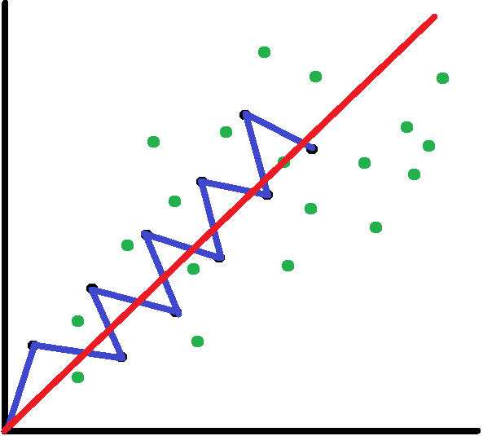
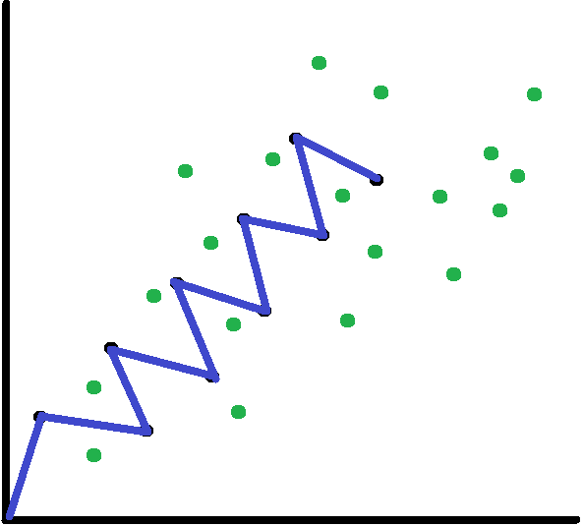
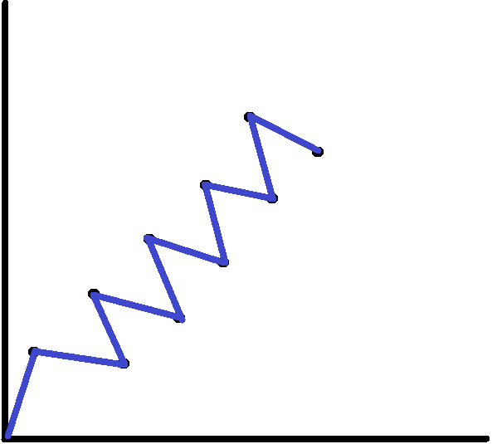
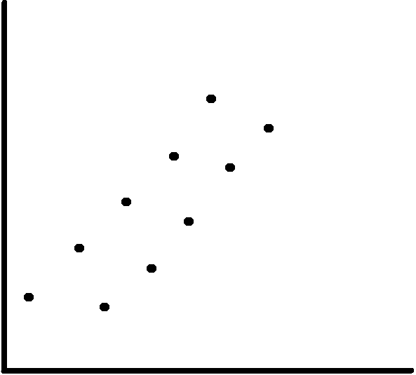
Model Complexity vs. Generality
Environmental variable 1
Environmental variable 2

Slide 5
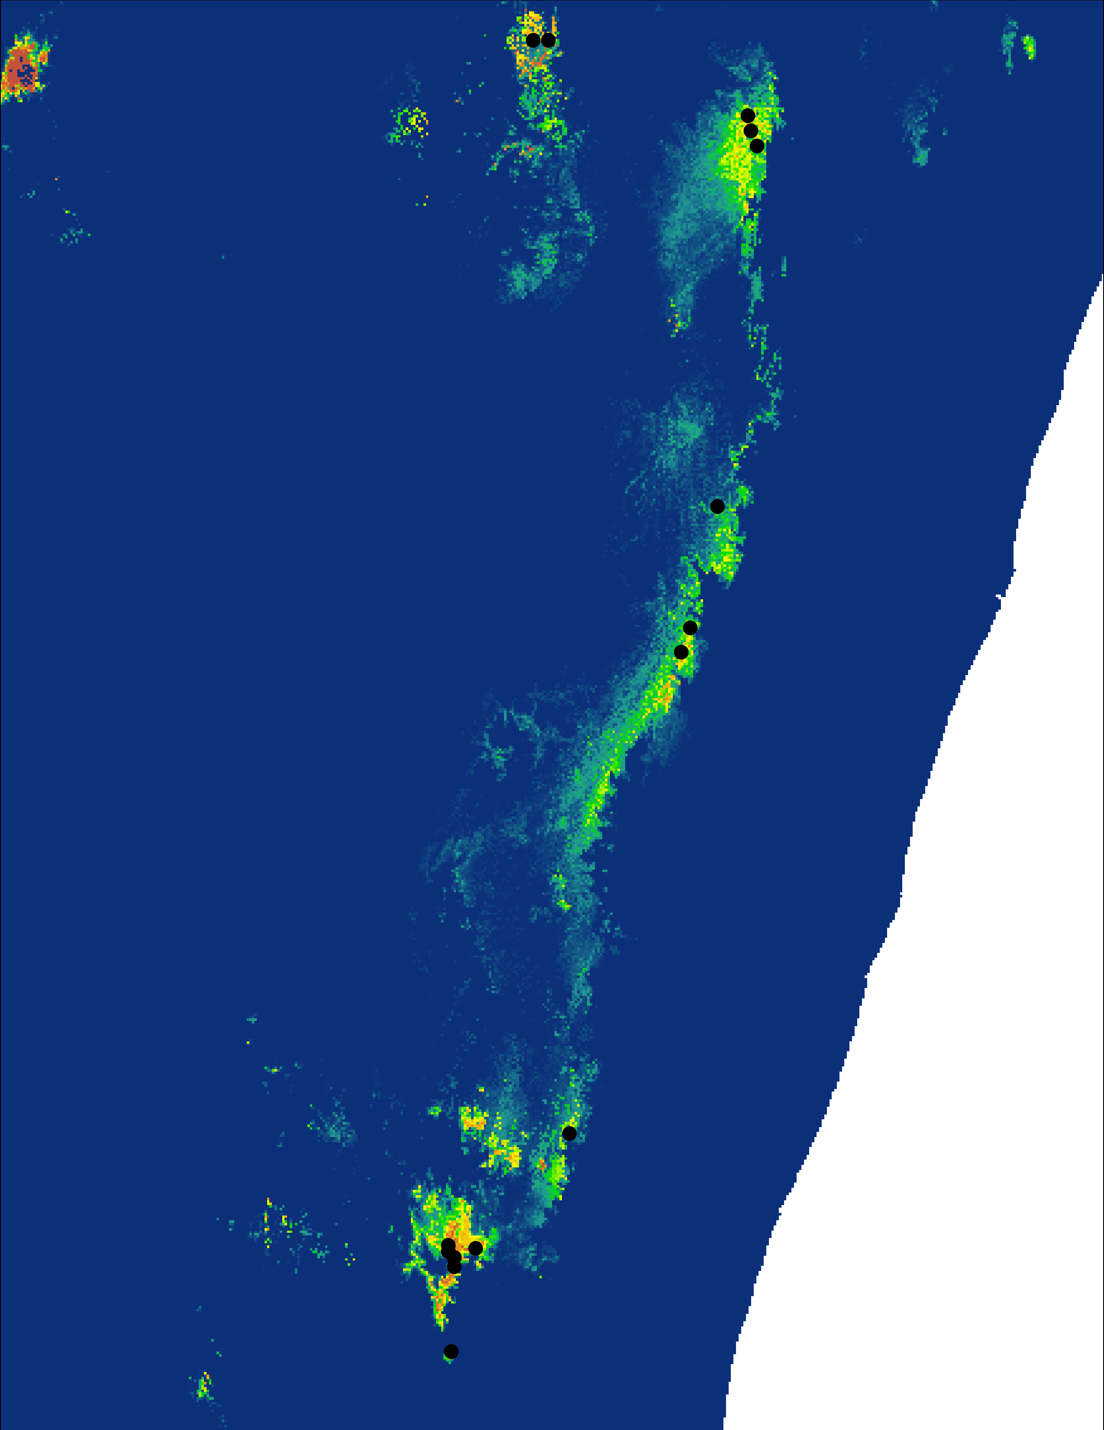
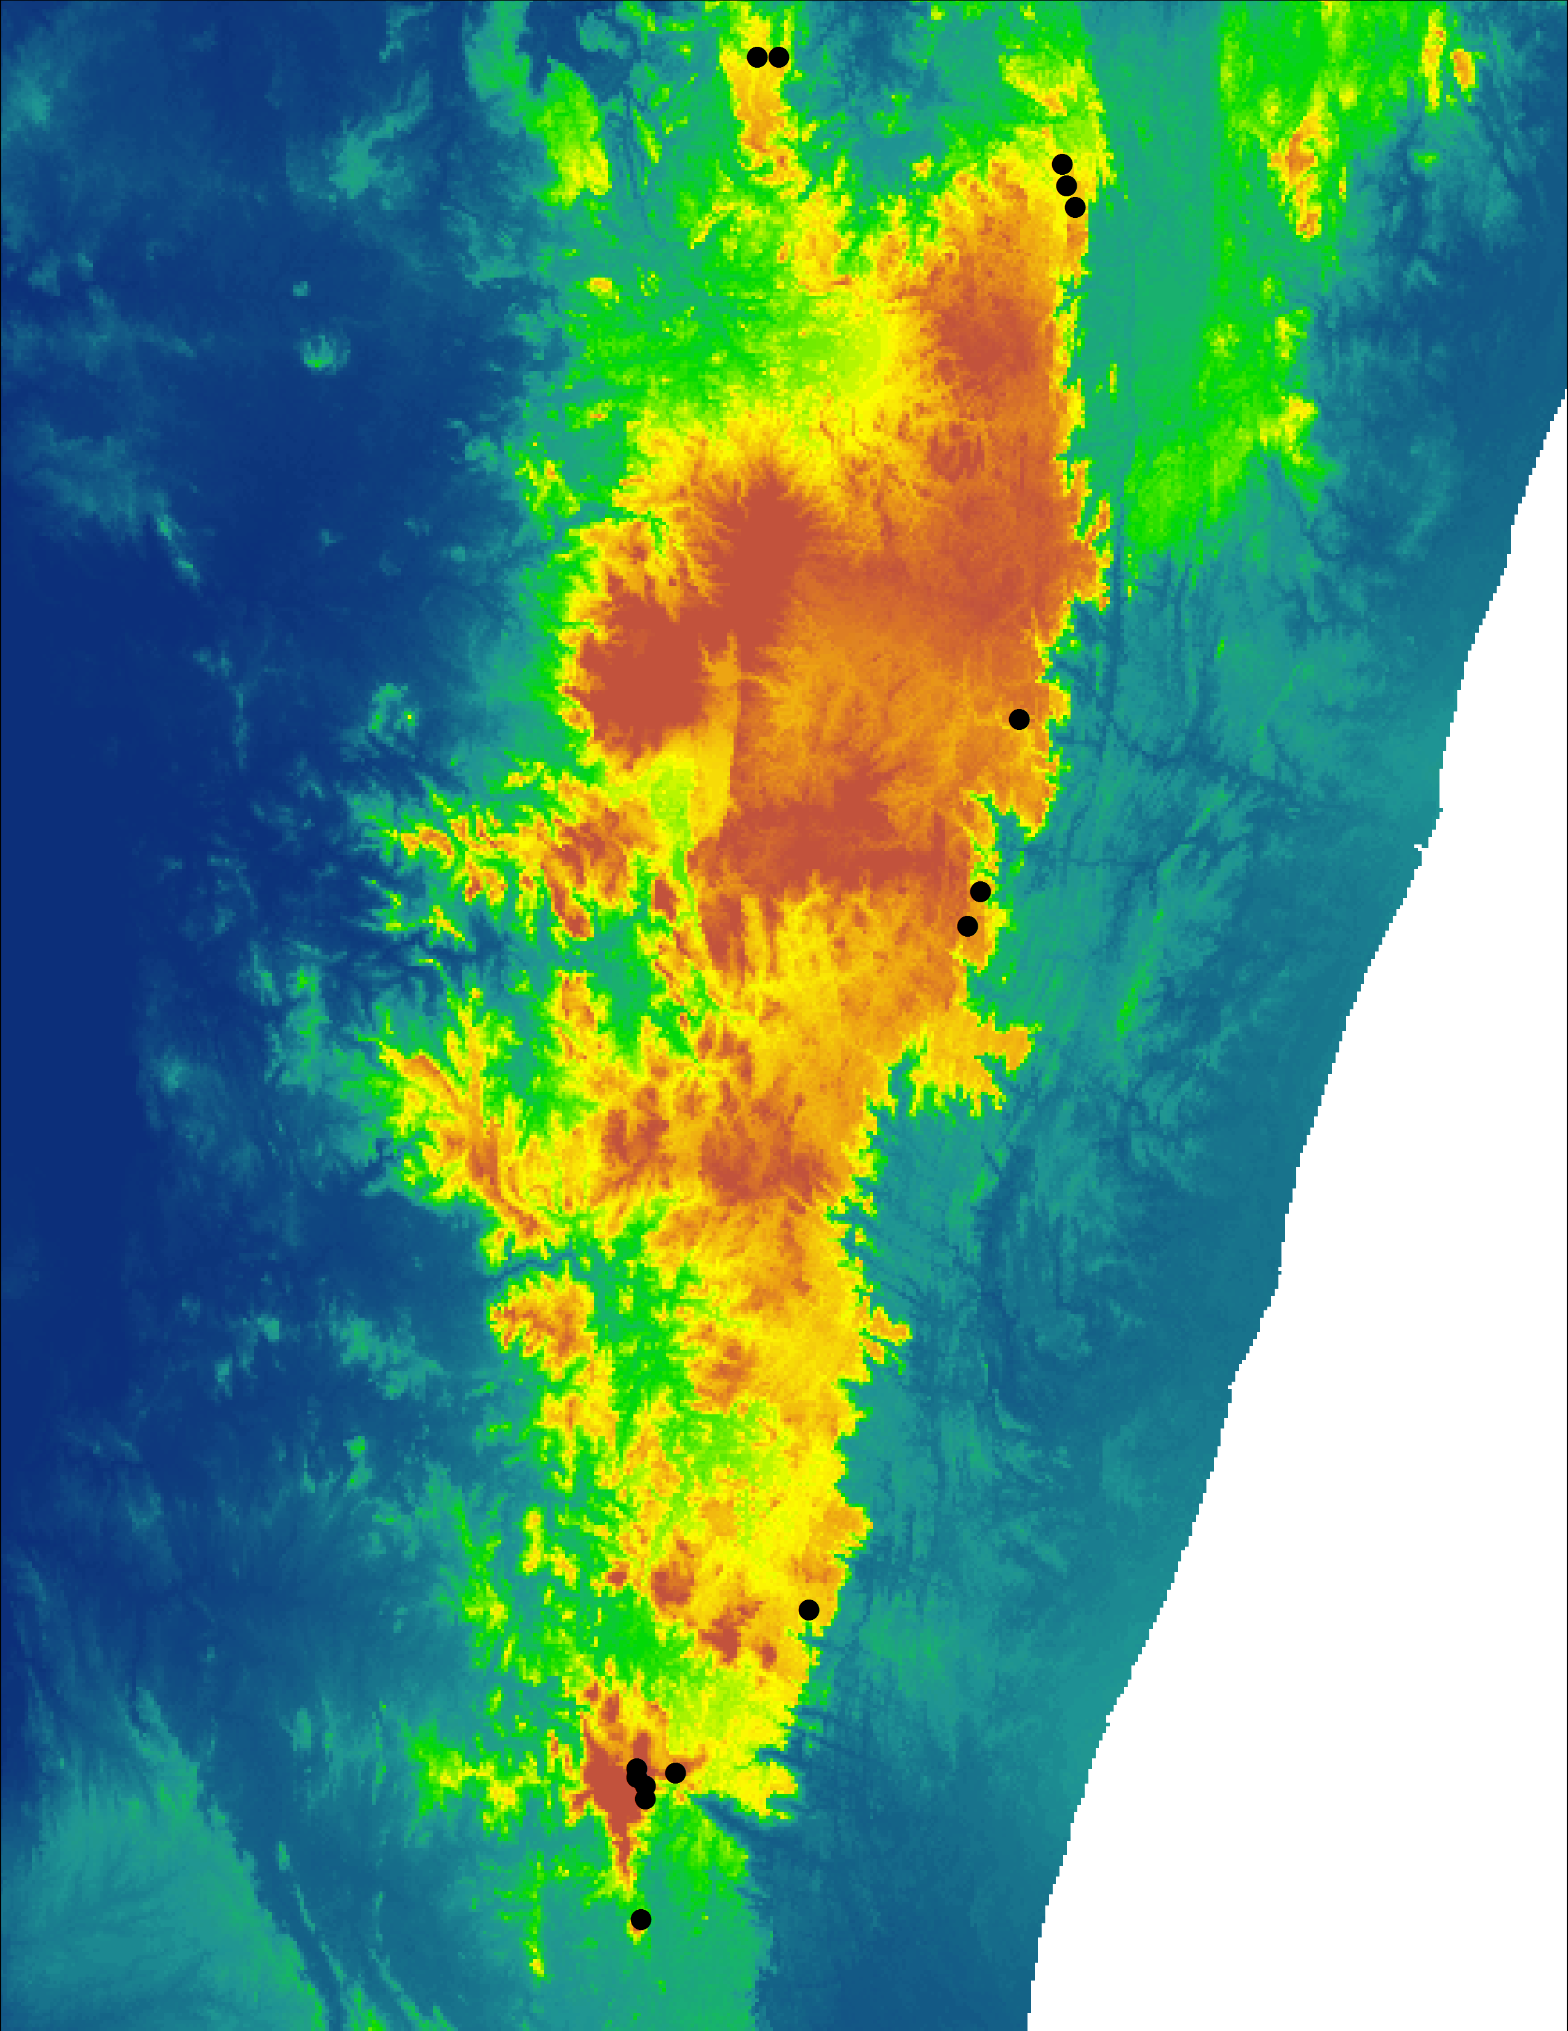
Model Selection
Complex
Simple

Slide 6
Model Tuning
Two settings in Maxent (in ENMeval):
Regularization multiplier:
Increasing regularization increases
penalties on model complexity
0 → ?
Feature classes
Allows flexibility of model response
Linear+Quadratic+Hinge
Linear + Quadratic
Quadratic
Linear
Hinge
Increasing complexity

Slide 7
Outline:
Maxent model tuning
Model validation
Model evaluation
Evaluation statistics
Model complexity and advanced considerations

Slide 8
Model calibration and evaluation strategies: independent validation
Projection
Same region
Different region
Different time
Different resolution
All available data
100%
Calibration
Independent data
Evaluation
(after Araújo et al. 2005 Gl. Ch. Biol.)
Notes:
It is preferable to use test data that is different from the calibration data. Ideally, test data would be collected independently of the data used to calibrate the model, as illustrated here.
For example, Fleishman et al. (2002) modeled the occurrence of butterfly species in Nevada (USA) using species inventory data collected during the period 1996-1999, and then tested the models using data collected from new sites during 2000-2001 (see the Madagascar case study toward the end of this presentation for a comparable study).

Slide 9
Model calibration and evaluation strategies: resubstitution
Projection
Calibration
Same region
Different region
Different time
Different resolution
All available data
100%
Evaluation
(after Araújo et al. 2005 Gl. Ch. Biol.)
Notes:
In order to test predictive performance it is necessary to have data against which the model prediction can be compared. We can refer to these as test data (sometimes called ‘evaluation data’) so as to distinguish from the calibration data that is used to build the model. It is fairly common for studies to assess predictive performance by simply testing the ability of the model to recreate the calibration data (i.e. calibration and test datasets are identical), as illustrated here. Students may be asked to identify limitations of this approach: the approach makes it difficult to identify models that have over-fit to the calibration data, making it impossible for users to judge how well the model will perform when predicting new datasets.

Slide 10
Notes:
We are showing you how to do random subsets, that is what Maxent does already.

Slide 11
Model calibration and evaluation strategies: data splitting
Projection
Calibration data
(or ‘training data’)
Calibration
70%
Same region
Different region
Different time
Different resolution
Test data
30%
Evaluation
(after Araújo et al. 2005 Gl. Ch. Biol.)
Notes:
In practice, it may not be possible to obtain independent test data and it is therefore common to partition the available data into calibration and test datasets. Several strategies are available for partitioning data, the simplest being a one-time split in which the available data are assigned to calibration and test datasets either randomly or by dividing the data spatially. The relative sizes of each part of the data split are somewhat arbitrary, though using 70% for calibration and 30% for testing is common.

Slide 12
Model calibration and evaluation strategies: cross validation/ k-fold partitioning
Split data randomly into k roughly equal-sized parts. Take turns using each part as a test set and the other k – 1 parts for model training.
Compute test statistic each time. Cross-validation estimate of predictive performance is the average of the k tests.
Full
data set
k = 5
k = 10
k = n
(jackknife)
= training set
= test set
n observations
(C. Graham)

Slide 13
Notes:
But you may want to do spatially independent subsets., for example.

Slide 14
Radosavljevic & Anderson 2014
Notes:
But need to mask the environmental layers as well for presence-background approaches like maxent.

Slide 17
Notes:
We will not do this in lab today, we’ll just do random partitioning, – but there is an R package that can do this if its appropriate for your dataset or if you want to do it in the future.

Slide 18
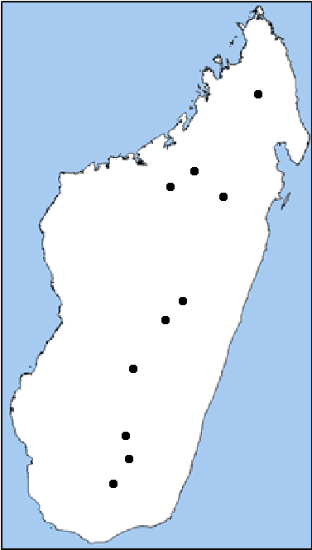






Slide 19
Model calibration and evaluation strategies: cross validation/ k-fold partitioning
Split data randomly into k roughly equal-sized parts. Take turns using each part as a test set and the other k – 1 parts for model training.
Compute test statistic each time. Cross-validation estimate of predictive performance is the average of the k tests.
= training set
Each Feature Class and Regularization Multiplier combination
= test set
X
n observations
(C. Graham)

Slide 20
Outline:
Maxent model tuning
Model validation
Model evaluation
Evaluation statistics
Model complexity and advanced considerations

Slide 21
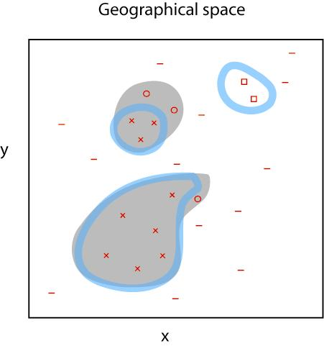
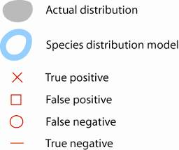
The four types of results that are possible
when testing a distribution model
 | True Condition
Predicted Condition | True Positive | False Positive
 | False Negative | True Negative
Notes:
Diagram illustrating the four types of results that are possible when assessing the predictive performance of a species distribution model: true positive, false positive, false negative and true negative predictions. The diagram uses the same hypothetical actual and modeled distributions as in Figure 3. Each instance of a red symbol on the map depicts a site that has been surveyed and presence or absence of the species recorded (it is assumed here that if a site falls within the actual distribution then the species will be detected). These surveyed sites constitute the test data.

Slide 22
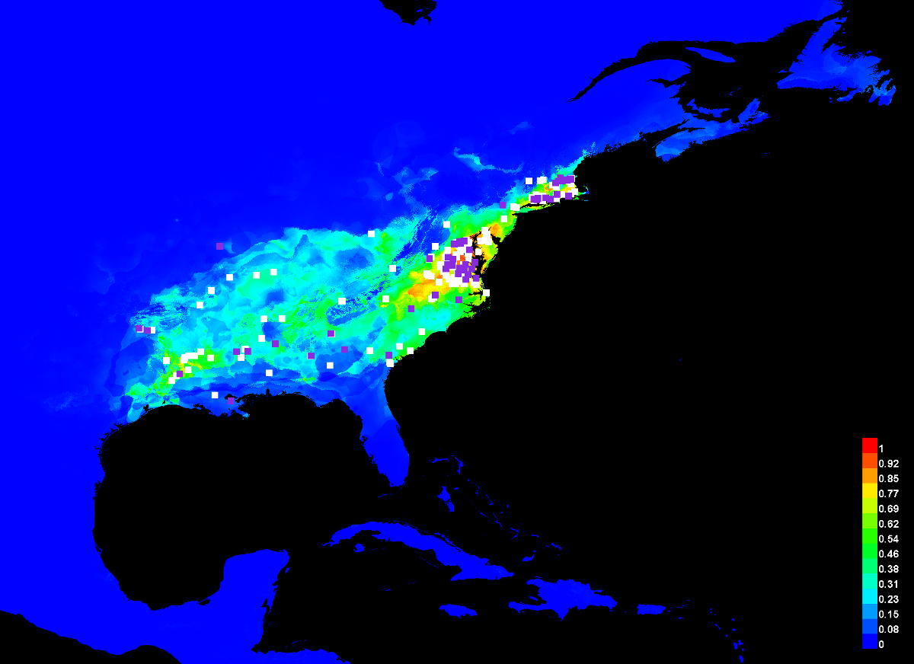
‘Continuous’ model output
Maxent model for the marbled salamander

Slide 23
Selecting a threshold with presence-only data
LPT
set percentile, e.g., 10%

Slide 24
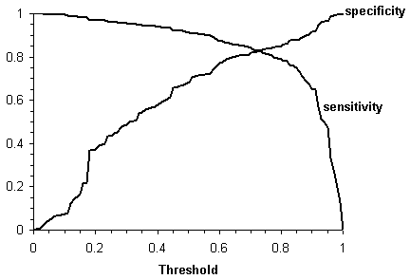
Selecting a threshold with presence/absence data
proportion of absences correctly predicted
proportion of presences correctly predicted

Slide 25
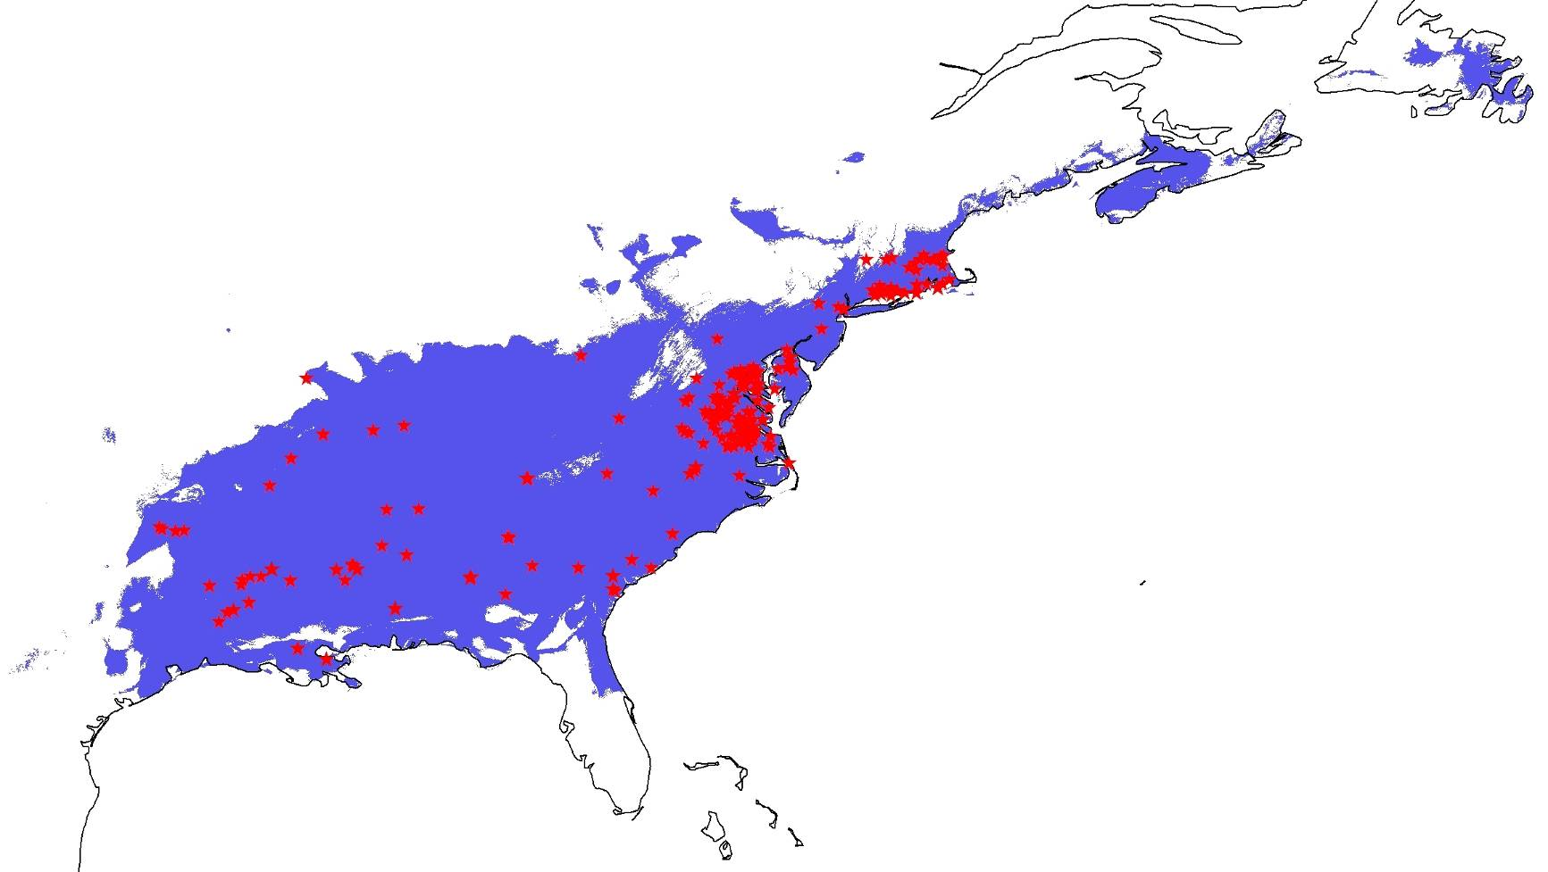
Thresholded model output
Maxent model for the marbled salamander with threshold applied

Slide 26
Outline:
Maxent model tuning
Model validation
Model evaluation
Evaluation statistics
Model complexity and advanced considerations

Slide 27
The four types of results that are possible
when testing a distribution model
Notes:
Diagram illustrating the four types of results that are possible when assessing the predictive performance of a species distribution model: true positive, false positive, false negative and true negative predictions. The diagram uses the same hypothetical actual and modeled distributions as in Figure 3. Each instance of a red symbol on the map depicts a site that has been surveyed and presence or absence of the species recorded (it is assumed here that if a site falls within the actual distribution then the species will be detected). These surveyed sites constitute the test data.

Slide 28
Presence-absence confusion matrix
Recorded (or assumed) absent
Recorded present
Predicted present
a (true positive)
b (false positive)
Predicted absent
c (false negative)
d (true negative)

Slide 29
Presence-only test statistics
Recorded (or assumed) absent
Recorded present
Predicted present
a (true positive)
b (false positive)
Predicted absent
c (false negative)
d (true negative)
Proportion of observed presences correctly predicted (or ‘sensitivity’, or ‘true positive fraction’):
a/(a + c)

Slide 30
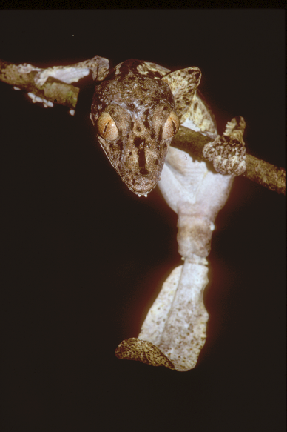
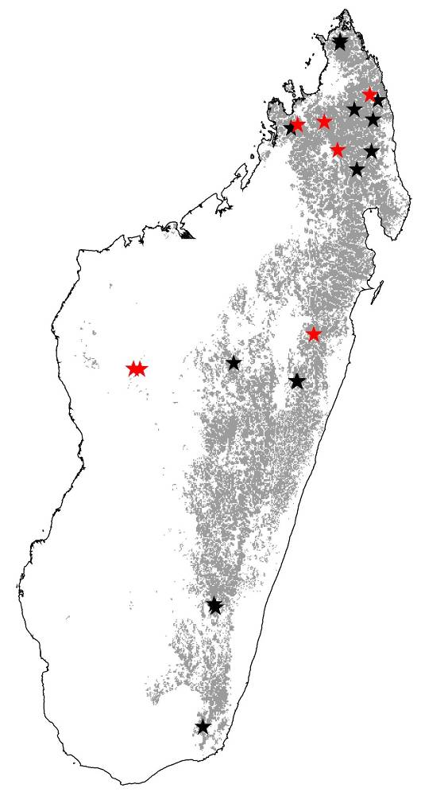
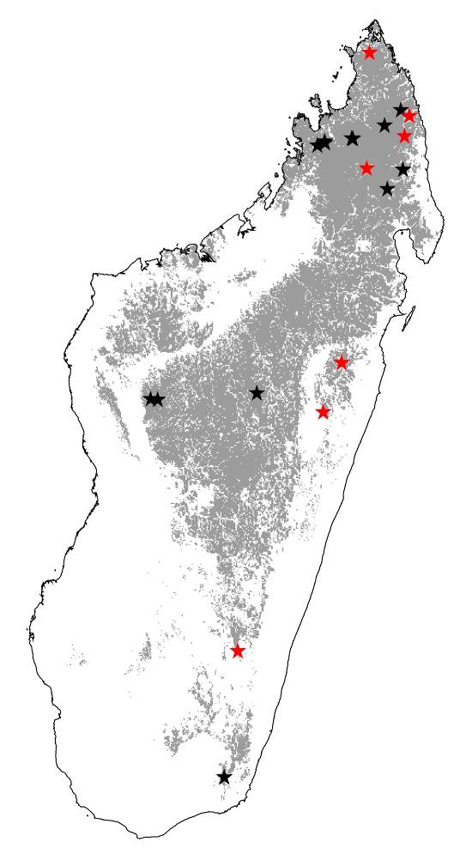
Presence-only test statistics: testing for statistical significance
Leaf-tailed gecko (Uroplatus)
U. sikorae
U. sikorae
Success rate: 4 from 7
Proportion predicted present: 0.231
Binomial p = 0.0546
Success rate: 6 from 7
Proportion predicted present: 0.339
Binomial p = 0.008

Slide 31
Presence-absence test statistics
Recorded (or assumed) absent
Recorded present
Predicted present
a (true positive)
b (false positive)
Predicted absent
c (false negative)
d (true negative)
Proportion of observed presences correctly predicted (or ‘sensitivity’):
a/(a + c)
Proportion of observed absences correctly predicted (or ‘specificity’):
d/(b + d)

Slide 32
The Receiver Operating Characteristic (ROC) Curve
A
B
set of ‘absences’
set of ‘presences’
1
Frequency
(Proportion of presences correctly predicted)
0
Predicted probability of occurrence
1
sensitivity
C
set of ‘absences’
set of ‘presences’
Frequency
0
0
1 - specificity
1
0
Predicted probability of occurrence
1
(proportion of absences incorrectly predicted)
(check out: http://www.anaesthetist.com/mnm/stats/roc/Findex.htm)
Notes:
When model output is continuous, assessment of predictive performance using statistics derived from the confusion matrix will be sensitive to the method used to select a threshold of occurrence. It is therefore often useful to derive a test statistic that provides a single measure of predictive performance across the full range of possible thresholds. This can be achieved using a statistic known as AUC: the Area Under the Receiver Operating Characteristic Curve.
The AUC test is derived from the Receiver Operating Characteristic (ROC) Curve. This slide shows example Receiver Operating Characteristic (ROC) Curves, and illustrative frequency distributions. Graph A: Plots of sensitivity against (1 - specificity) to form ROC curves. Two ROC curves are shown, the upper curve (red) signifying superior predictive ability. The dashed 1:1 line signifies random predictive ability, whereby there is no ability to distinguish occupied and unoccupied sites. Graphs B and C show example frequency distributions of probabilities predicted by a model for observed ‘presences’ and ‘absences’. The results shown in graph B reveal good ability to distinguish presence from absence, whilst results in graph C show more overlap between the frequency distributions thus revealing poorer classification ability. The case shown in graph B would produce an ROC curve similar to the upper (red) curve in graph A. The case shown in graph C would give an ROC curve more like the lower (blue) curve in graph A.
In order to summarize predictive performance across the full range of thresholds we can measure the area under the ROC curve (AUC), expressed as a proportion of the total area of the unit square defined by the axes. The AUC thus ranges from 0.5 for models that are no better than random, to 1.0 for models with perfect predictive ability. AUC is a test that uses both presence and absence records.

Slide 33
So, what is a ‘good’ result?
Some subjective guidelines (after Swets 1988 Science) :
0.5 – 0.7: poor discrimination
0.7 – 0.9: reasonable discrimination
0.9 – 1.0: very good discrimination
However, note that the Maxent software generates AUC statistics using ‘background’ rather than absence data, so the maximum achievable AUC score is <1 (see Phillips et al. 2006).
Notes:
Note you should report the evaluation AUCs of test data rather than the AUC for model calibration (with all points). A useful thing to look at sometimes is the difference between calibration and evaluation AUC (so how much worse the AUC is of the test data).
Normally, I would end here – and some of you can tune out at this juncture, because that is all you really need to know for this class and your independent projects…

Slide 34
Outline:
Maxent model tuning
Model validation
Model evaluation
Evaluation statistics
Model complexity and advanced considerations

Slide 35
Advanced considerations
Model complexity:
Occurrence data suffer from (among other things):
Biased sampling across geography
Which may also be biased in environmental space
Overly complex models may overfit to this bias (or to noise)
What is overly complex?
Number of variables, feature classes considered, level of regularization
Notes:
But for those nerds amongst you who might really go into using these methods for your dissertations, there are some additional things to consider that have been brought up by researchers as these methods have developed (explosively) for studies of biogeography and conservation.
Keep in mind that these are some things that you may not be able to address in the context of this course – but for any peer-reviewed publication of model results, they are things you might consider.

Slide 36
Overfitting
Notes:
So you want to test several different regularization values, typically. People often settle around 1 or 2, but depends on each dataset.

Slide 37
Advanced considerations
Background selection
Notes:
Keep in mind that these are some things that you may not be able to address in the context of this course – but for any peer-reviewed publication of model results, they are things you might consider.
You’ll be learning how to run a Maxent model in R today, so these are some R packages that would allow you to implement some of the advanced methods.
However, in many cases, we have too few occurrence records to be able to take anything out or even generate a bias layer one way or the other! And in that case you can do a jacknife test (see richard’s 2007 paper in additional readings).

Slide 38
Advanced considerations
ENMEval R package
Try different regularization values, design spatially independent training and test datasets, feature classes, number of variables (Muscarella et al. 2014)
SDMToolbox for ArcGIS also does some of this (Brown et al. 2014)
spThin R package
thin occurrence records re: spatial autocorrelation bias (Aiello-Lammens et al. 2015)
Bias layer for Maxent
for known sampling bias masking (Phillips et al. 2009)
Notes:
Keep in mind that these are some things that you may not be able to address in the context of this course – but for any peer-reviewed publication of model results, they are things you might consider.
You’ll be learning how to run a Maxent model in R today, so these are some R packages that would allow you to implement some of the advanced methods.
However, in many cases, we have too few occurrence records to be able to take anything out or even generate a bias layer one way or the other! And in that case you can do a jacknife test (see richard’s 2007 paper in additional readings).

Slide 39
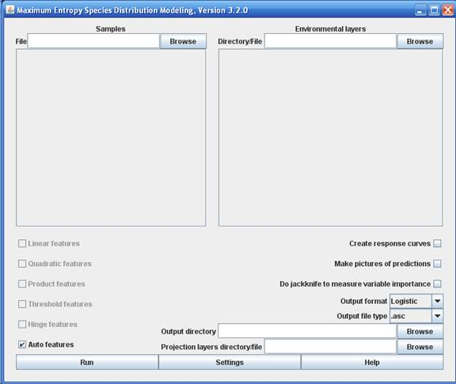
Feature Classes

Slide 40
